Slide 1
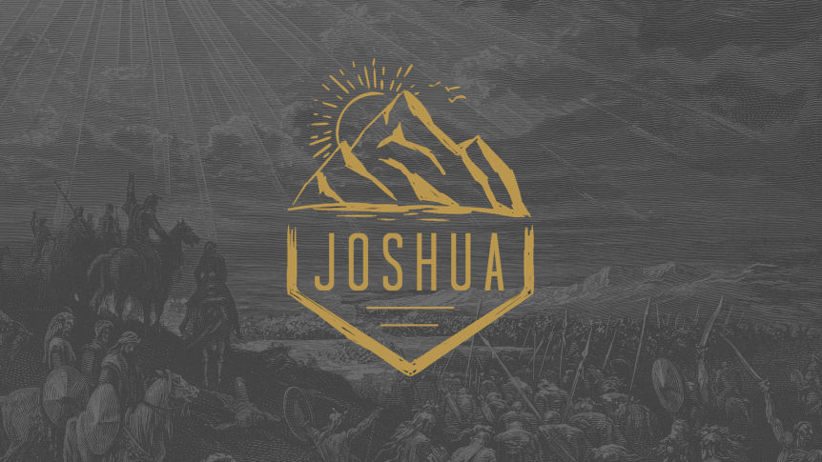

Slide 2
* God will never lead us where His grace cannot provide for us!
*God will never lead us where His power cannot protect us.

Slide 4
15 It was the harvest season, and the Jordan was overflowing its banks. But as soon as the feet of the priests who were carrying the Ark touched the water at the river’s edge,

Slide 5
16 the water above that point began backing up a great distance away at a town called Adam, which is near Zarethan. And the water below that point flowed on to the Dead Sea until the riverbed was dry. Then all the people crossed over near the town of Jericho.

Slide 6
17 Meanwhile, the priests who were carrying the Ark of the Lord’s Covenant stood on dry ground in the middle of the riverbed as the people passed by. They waited there until The Whole Nation of Israel had crossed the Jordan on dry ground.

Slide 8
1. God Controls the Flow!

Slide 10
1 When all the people had crossed the Jordan, the Lord said to Joshua, 2 “Now choose twelve men, one from each tribe.

Slide 11
3 Tell them, ‘Take twelve stones from the very place where the priests are standing in the middle of the Jordan. Carry them out and pile them up at the place where you will camp tonight.’”

Slide 12
4 So Joshua called together the twelve men he had chosen—one from each of the tribes of Israel. 5 He told them, “Go into the middle of the Jordan, in front of the Ark of the Lord your God. Each of you must pick up one stone and carry it out on your shoulder—twelve stones in all, one for each of the twelve tribes of Israel.

Slide 13
6 We will use these stones to build a memorial. In the future your children will ask you, ‘What do these stones mean?’ 7 Then you can tell them, ‘They remind us that the Jordan River stopped flowing when the Ark of the Lord’s Covenant went across.’ These stones will stand as a memorial among the people of Israel forever.”

Slide 14
8 So the men did as Joshua had commanded them. They took twelve stones from the middle of the Jordan River, one for each tribe, just as the Lord had told Joshua. They carried them to the place where they camped for the night and constructed the memorial there.

Slide 15
9 Joshua also set up another pile of twelve stones in the middle of the Jordan, at the place where the priests who carried the Ark of the Covenant were standing. And they are there to this day.

Slide 16
10 The priests who were carrying the Ark stood in the middle of the river until all of the Lord’s commands that Moses had given to Joshua were carried out. Meanwhile, the people hurried across the riverbed.

Slide 17
2.God makes a way when there is
no other way!

Slide 19
*OUR FAITH CAN MOVE MOUNTIANS
*OUR FAITH CAN PART WATERS
*OUR FAITH CAN MAKE A WAY FOR OTHERS TO EXPERIENCE THE LORD!

