Slide 1

From death
LIFE
to

Slide 2

6 Then Jesus told this story:
“A man planted a fig tree in his garden and came again and again to see if there was any fruit on it, but he was always disappointed.

Slide 3
7 Finally, he said to his gardener, ‘I’ve waited three years, and there hasn’t been a single fig! Cut it down. It’s just taking up space in the garden.’

Slide 4
8 “The gardener answered, ‘Sir, give it one more chance. Leave it another year, and I’ll give it special attention, Dig around it and give it plenty of fertilizer.

Slide 5
9 If we get figs next year, fine. If not, then you can cut it down.’”

Slide 6
1.Procrastination does not help

Slide 7
2. Let God work on our roots
even when it hurts.

Slide 8
3. God can bring to
life things we think are dead!

Slide 10
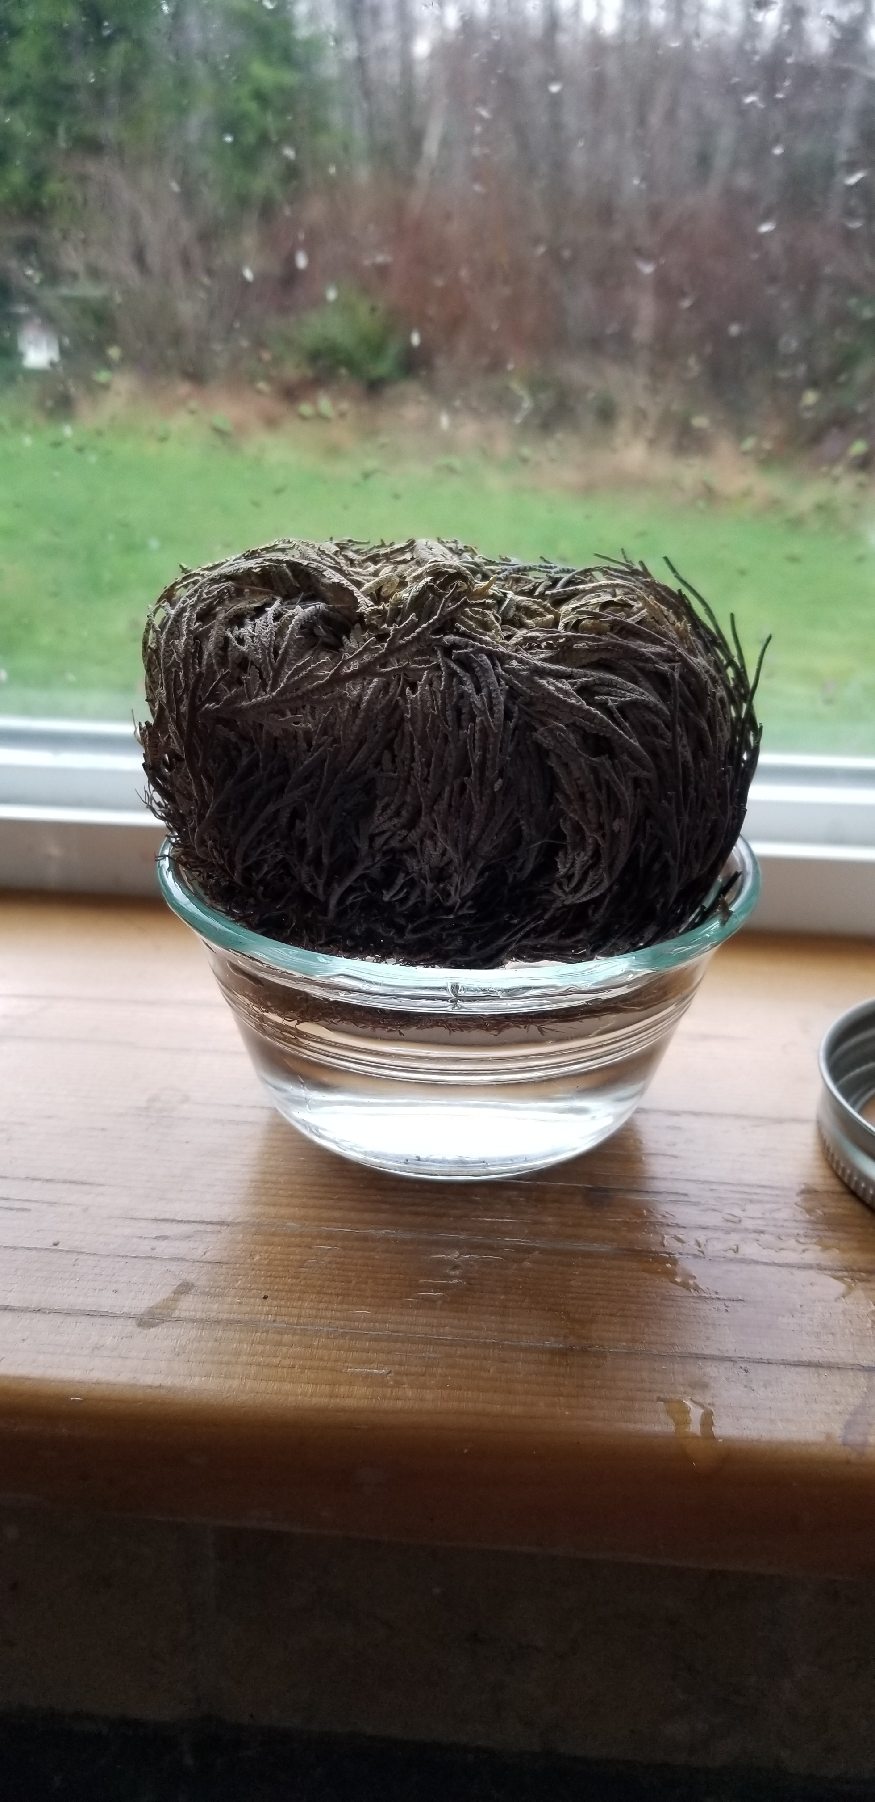

Slide 11
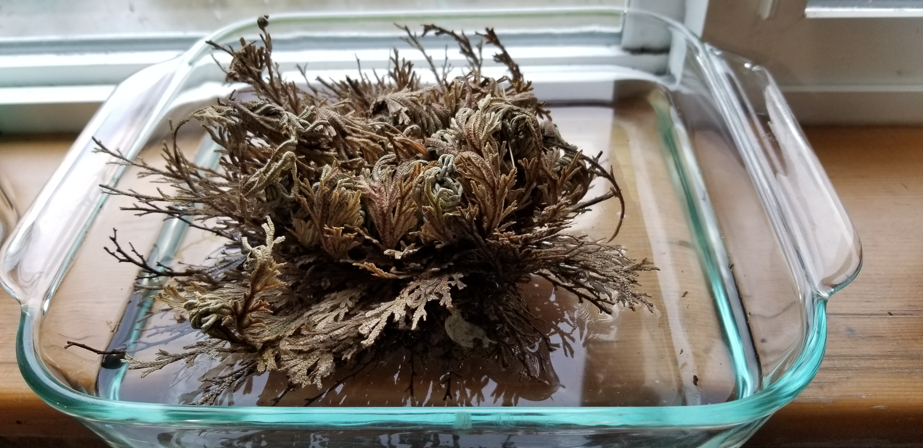
2 hrs

Slide 12
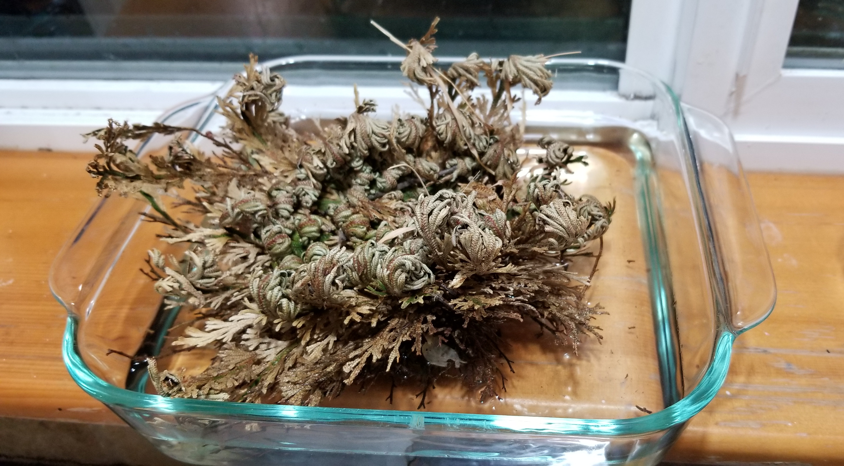
12 hrs

Slide 13
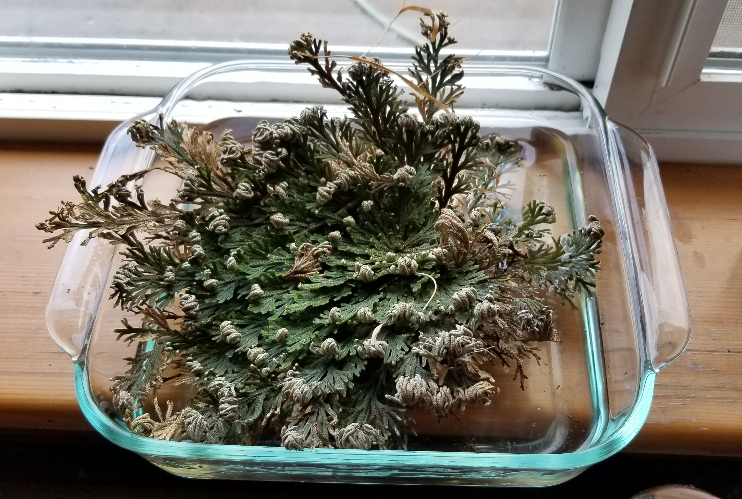
24 hrs

Slide 14
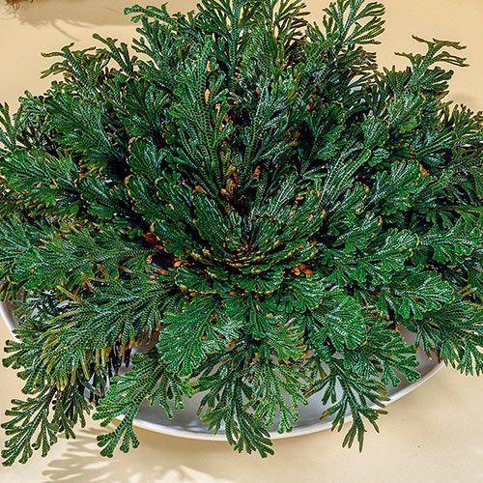

Slide 15
Don’t procrastinate.
Let God dig around
our roots even when it
Hurts.
3.Let the power of God
bring life to the things
we thought were dead.
LIFE

